Slide 1
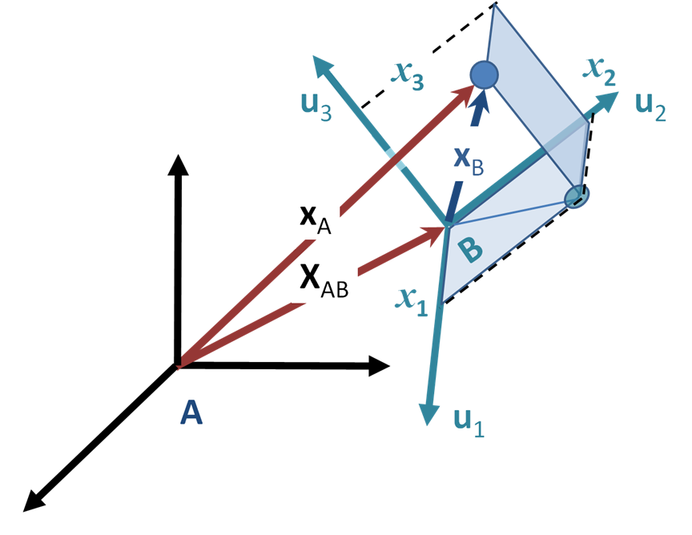
Conclusion
Major project issue left to resolve: System wide reference frame
Image courtesy of Wikipedia

Slide 2
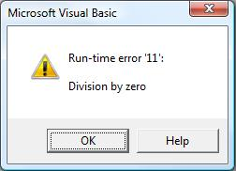
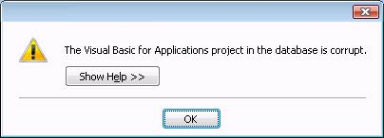
Conclusion
System error handling and control
Image courtesy of Microsoft
Image courtesy of FMS Inc.

Slide 3
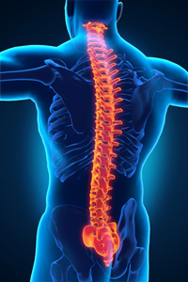

Conclusion
Spine Research Institute of Ohio State University POC: Dr. William Marras (center)
Image courtesy Dr. William Marras
Image courtesy Ohio State University

Slide 4

Thank You!
Image courtesy of the University of Buffalo

